Slide 1
GROUP 4 - PART 3 PRESENTATION
By
Bhavya Devineni
Kalyan Purushotham Karra
Nevetha Balasubramanian
Praveen Kumar Govindaraj
Raghunath Viswanath Nallapeta
Sridevi Rachakulla
Sushma Venkatesh Reddy
Vishwanarayan Sriganesh

Slide 2








DATA COLLECTION PROCESS

Slide 3
DESCRIPTIVE STATISTICS- F500 COMPANIES
CATEGORY | SIZE (RECORDS) | AVERAGE | MAX | RANGE | STD DEV
Patent | 2,14,518 | 429.036 | 49105 (IBM) | 49105 | 2617.277
Revenue | 500 | 142214.9 | 3098376 (Walmart) | 3098376 | 250655.4
CSR Index | 500 | 8.0% | 47% (GE) | 47 | 0.07105

Slide 4
Relationship AMONGST VARIABLES
VARIABLE | VARIABLE | RELATIONSHIP
Patent | Revenue | Directly Related
Revenue | CSR Index | Directly Related
CSR Index | Patent | Not Related
Election | Revenue | Not Related
Election | Patent | Not Related

Slide 5

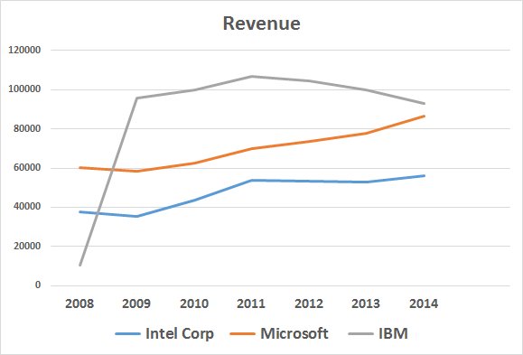
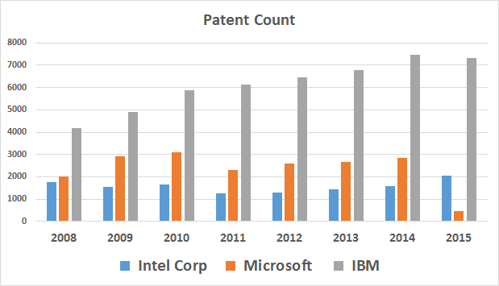
IBM - HIGHEST PATENT COUNT
IBM
Microsoft
Intel

Slide 6
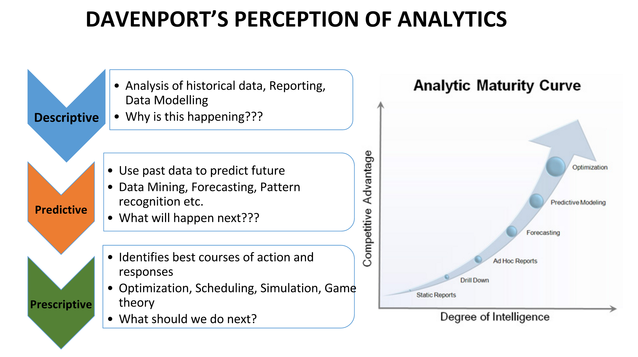
IBM - HIGHEST PATENT COUNT

Slide 7
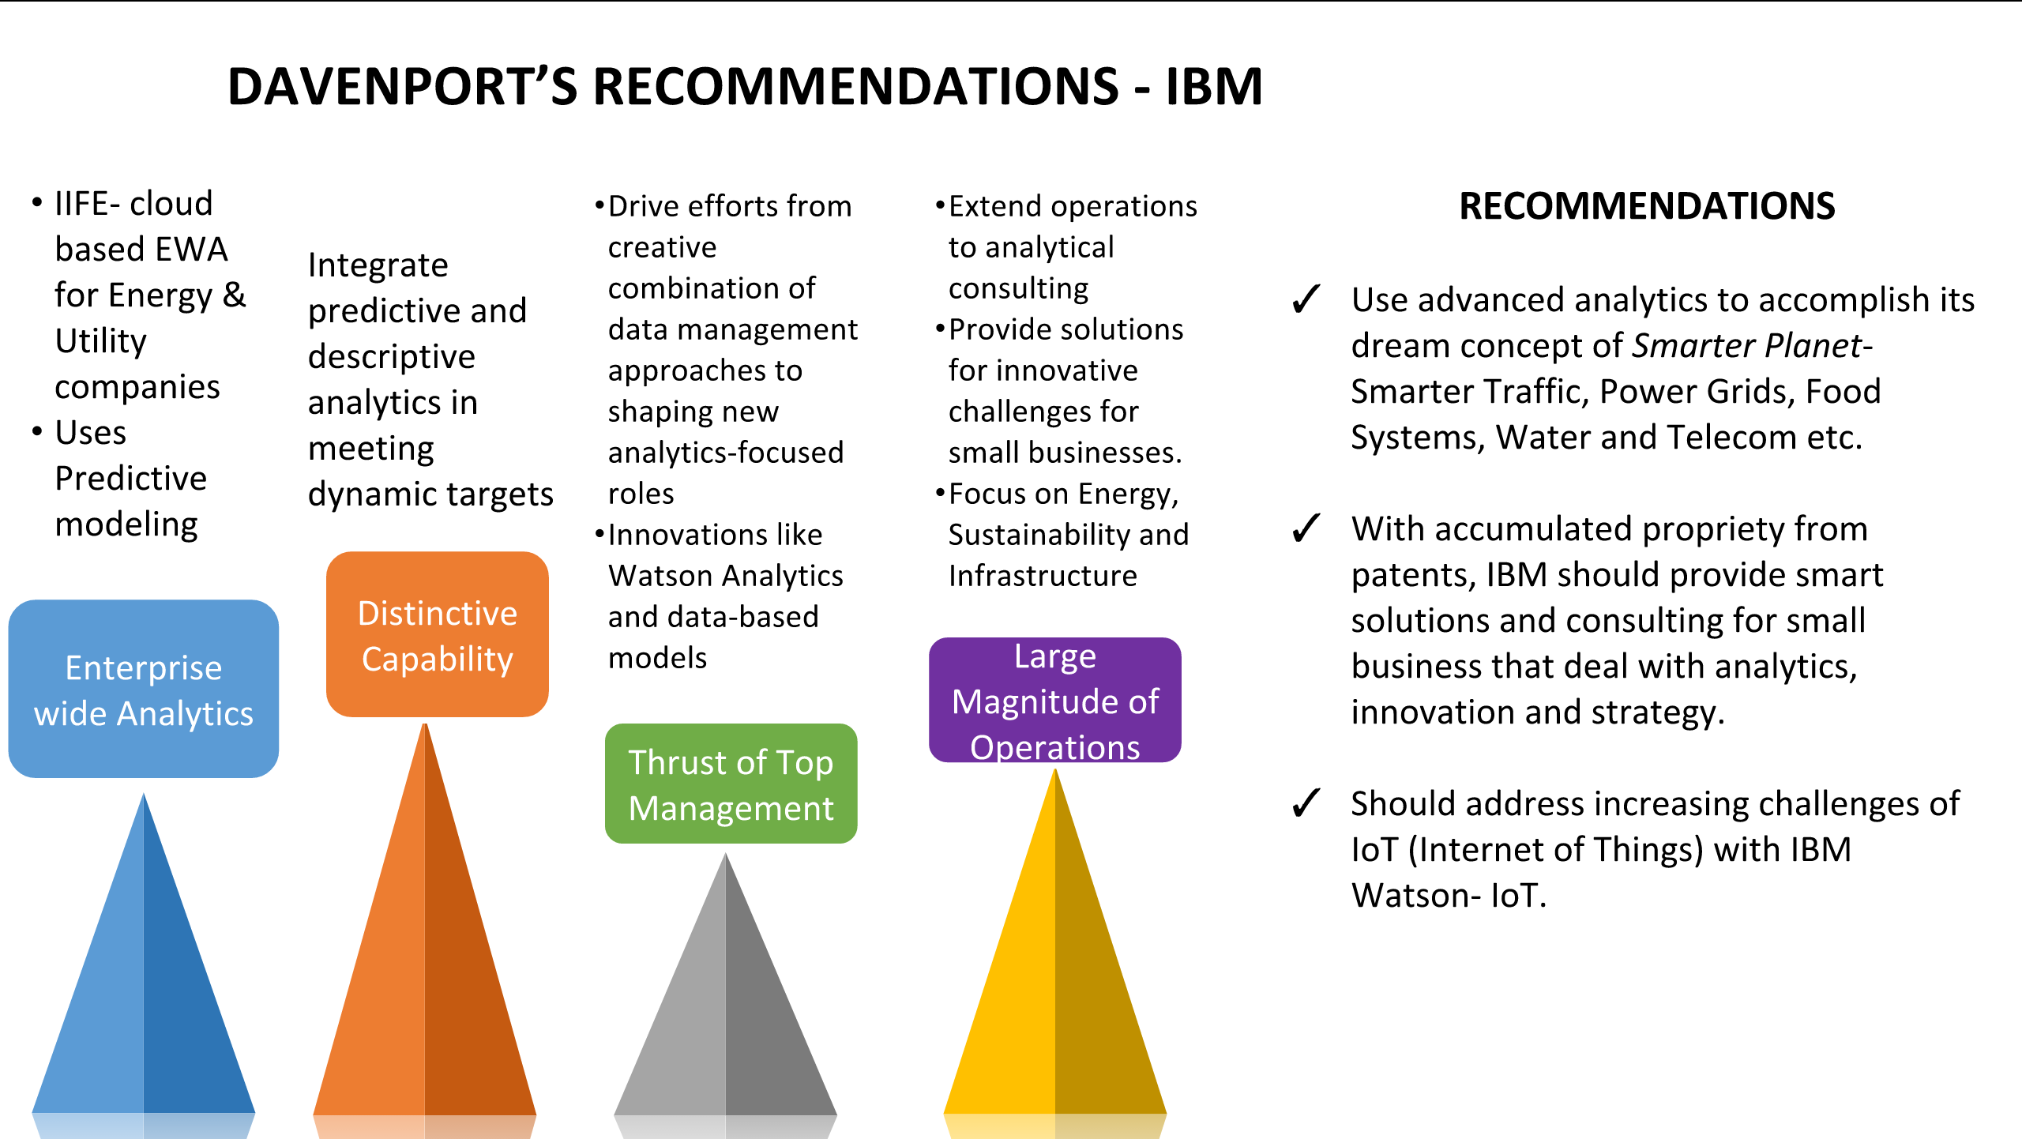
IBM - HIGHEST PATENT COUNT
RATING GIVEN: 5 (EXCELLENT), BASED ON 5 STAGES OF ANALYTICAL MATURITY

Slide 8
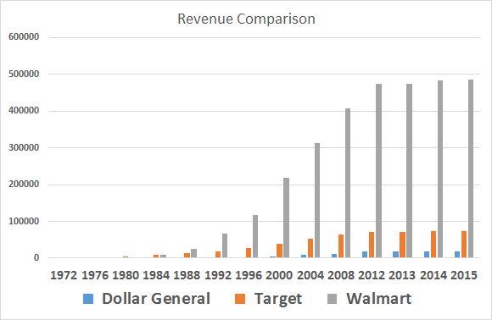
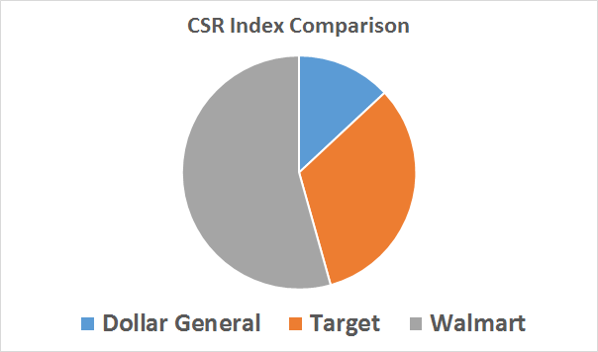
WALMART – HIGHEST REVENUE
10%
52%
38%

Slide 9

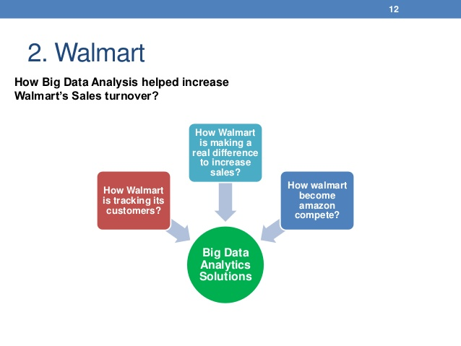
DAVENPORT’S ANALYSIS
Mobility and big data: The Geofencing feature of Walmart’s mobile app senses a user’s entry and pops up to enter into the “Store Mode”.
The store mode helps users to scan QE codes for special discounts and offers on products they would like to buy
Acquisition of aN analytics firm: ‘INKIRU’ is used to improve personalization through data analytics
Big data technology: Text mining on social media data, gift recommendation engine, social genome
Business application of analytics: Customized recommendation, launching new products, better predictive analytics, inventory management
Analytics rotation program: Spending a period within every department to get an overview of how analytics is used across the company
RECOMMENDATIONS
Building a Business for sharing the Profits gained with the associates and employees, for better work performance encouragement.
Focusing on training the current employees in the booming field that is vital for the company’s growth
Getting new employees keeping in mind about the predictive analytical needs
RATING GIVEN: 5 (EXCELLENT), BASED ON 5 STAGES OF ANALYTICAL MATURITY

Slide 10
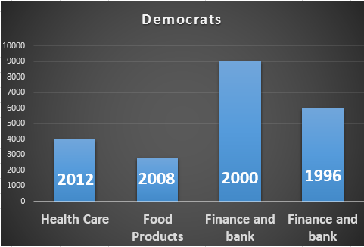
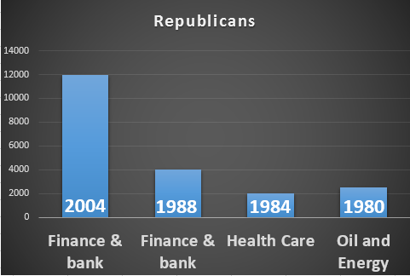
IMPACT OF US PRESIDENTIAL ELECTIONS
INFERENCES:
Presidential elections “do not have significant impact” on the fortune 500 COMPANIEs’ Revenue.

Slide 11

LIMITATIONS AND CONCLUSION
ASSUMPTIONS
Patent count for the Fortune 500 companies hold good only for the period (2008 - 2014)
Presidential Election Sponsorship holds good only for those companies whose data is consistent and reliable
For better visualization of CSR using the Cluster analysis, we have considered only 3 attributes (CSR Index, Charity and Community)
LIMITATION The K-10 reports that have been collected challenged us in providing more insight related to Analytics and Innovation
CONCLUSION
Election does not have influence on the revenues of organizations, however it depends on other factors as well.

Slide 12

THANK YOU!!
Any Questions ?

